Slide 1
2026 Urgent and Emergency Care Survey (UEC26)
Trust Webinar 2
Thursday 12th February, 11am – 12:30pm

Slide 2
Contents
Overview of 2026 Urgent and Emergency Care Survey (UEC26) [10 mins]
Potential sampling errors [5 mins]
Sampling and contact approach [15 mins]
Patient facing materials [10 mins]
Questionnaire development: survey questions [15 mins]
Data protection and Section 251 requirements [5 mins]
Demographic Batch Services (DBS) checks [5 mins]
Instruction manuals [10 mins]
Entering fieldwork [5 mins]
Key dates [5 mins]
Questions [5 mins]

Slide 3
Overview of 2026 Urgent and Emergency Care Survey (UEC26)

Slide 4
Overview of 2026 Urgent and Emergency Care Survey (UEC26)
Mixed mode approach
Mixed mode approach i.e. online survey, paper questionnaires (Type 1, Type 3) with 8 pages, similar in design to UEC24.
Push to web e.g. inclusion of QR codes and website links on cover letters; SMS texts with survey links.
Centralised survey offered for NHS Trusts conducting the survey in-house.
A range of accessibility features offered e.g. BSL, translations, multi-language sheet, screen-reader compatibility.
Contact approach updated to allow more time between postal and SMS contacts.
Sampling criteria
Eligibility criteria remains the same as 2024: 16+ years or older and must have visited an Accident & Emergency (A&E) department or an Urgent Treatment Centre (UTC) / Urgent Care Centre (UCC) / Minor Injuries Unit (MIU) in February 2026 (Type 3 samples can include patients with attendances from January 2026 if needed, to meet the required sample size).
Sampling variables
Sample variables Emergency Care Chief Complaints, Diagnosis and Person score have been removed for 2026. All other variables will remain the same as 2024. NHS numbers will be collected for DBS checks only (not for the linkage to Emergency Care Data Set) and are not to be shared with the SCC.
Questionnaire updates
Updates following stakeholder consultations, focus groups and cognitive testing will be discussed. Please note that where possible, the 2026 survey will aim to keep trend data.

Slide 5
Sampling and contact approach

Slide 6
Sampling: approach
Sampling approach
Sampling remains the same as the 2024 Urgent and Emergency Care Survey (UEC24).
A stratified random sampling approach will be adopted, with patients aged 16 years or older.
Sampling month: February 2026
Type 3 samples only: Trusts can extend the sampling period by including patients who attended urgent and emergency care services (UTC) in January 2026 working backwards from the last day of the month (31 January 2026) until the target sample size is achieved.
Trusts must not sample back before 1 January 2026. If Trusts reach the 1 January 2026 and do not have the required sample size, they should submit the Type 3 sample with the number of eligible patients that is available and confirm the final sample size with the SCC team.
Type 1 samples only
Type 1 and 3 samples
Sample size of 1,250 patients who attended A&E in February 2026.
Submit a combined sample and mailing file to approved contractors.
Draw 950 Type 1 patients who attended A&E in February 2026.
Draw 580 Type 3 patients who attended UTC services in February 2026.
Only Type 3 samples can sample back to 1 January 2026 if needed.
NOTE: Trusts may only submit Type 3 samples if the Type 3 departments are directly run by that Trust. Departments run by another provider are not eligible.
Further information will be made available in the Sampling Instructions, published on the NHS patient surveys website in February 2026.

Slide 7

Sampling: eligibility criteria (2)
Please do not include patients who:
Are aged younger than 16 years old at the time of ATTENDANCE to an A&E department (Type 1) or UTC (Type 3).
Deceased patients – identified via DBS and / or local checks.
Attendances at Walk-In Centres.
Attendances at Type 3 departments not wholly managed by your trust.
Patients admitted to hospital via Medical or Surgical Admissions Units, who did not have an attendance at an A&E department or UTC.
Current inpatients at the time of sampling.
Planned attendances at outpatient clinics run within A&E or UTC (such as fracture clinics).
Patients who attended or were streamed to a separate Same Day Emergency Care (SDEC) unit.
Patients attending primarily to attend contraception or suffered a miscarriage or another form of abortive pregnancy outcome whilst at the hospital.
Patients without a UK postal address – if addresses are incomplete but still usable, then patients can still be included.
Patients with addresses outside of the UK – British Islands patients are eligible, along with patients based at a military base, care homes, GP practice or a prison establishment.
Patients who have dissented or requested their details not be used for any other purpose outside of clinical care.
Please note that missing NHS numbers are not an exclusion criteria; patients should still be included in the sample if they have missing NHS numbers, providing they meeting all other eligibility criteria.

Slide 8
Contact approach
The contact approach has been updated as a cross-programme change following contractor feedback on postal issues. The new approach is as follows:
Contact type | Content | Days from first mailing | Days between each mailing | Example of mailing days
1.0 Postal – 1st contact | Invitation letter with URL and login details (including QR code) for online survey. Multi-language sheet with QR codes. | 0 | 0 | Monday
1.1 SMS – 1st reminder | Reminder sent to complete the online survey (if mobile number is available). | 5 | 5 working days after contact 1.0 | Monday
2.0 Postal – 2nd reminder | Invitation letter with URL and login details (including QR code) for online survey. Multi-language sheet with QR codes. | 7 | 7 working days after contact 1.0 | Wednesday
2.1 SMS – 3rd reminder | Reminder sent to complete the online survey (if mobile number is available). | 12 | 5 working days after contact 2.0 | Wednesday
3.0 Postal – 4th reminder | Invitation letter with URL and login details (including QR code) for online survey. Paper questionnaire sent with freepost return envelope. Multi-language sheet with QR codes. | 17 | 10 working days after contact 2.0 | Wednesday
3.1 SMS – final reminder | Reminder sent to complete the online survey (if mobile number is available). | 22 | 5 working days after contact 3.0 | Wednesday
Please ensure that DBS and local checks are provided in plenty of time to allow mailings to be sent on time.
Trusts will need to work alongside their approved contractors to agree on dates to complete DBS and local checks before the start of fieldwork and ahead of each mailing. More detail on DBS and local checks will be covered soon.

Slide 9
Potential sampling errors

Slide 10
Common sampling errors
Below are a list of checks that should be done before you submit your sample to your approved contractor or to the SCC:
Check the distribution of patient ages and patient gender in your sample; ensure patients are aged 16 or over at the time of attendance.
Are there any errors in the query used to extract the eligible patient populations?
Are there any missing / incomplete data in your initial database? Are there any duplicate records in your initial database?
Have the local checks for deceased patients / DBS been done correctly?
Be aware of system migrations.
Ensure patients on the national data opt-out programme are not excluded.
Ensure patients who have dissented to taking part are excluded.
Check all codes provided in your sample are valid.
Check for incorrect ethnicity coding or year of birth data.
Check all attendances took place in February 2026 (or for Type 3 only, January 2026 if you had fewer than 580 attendances in February).
Check your Sub ICB location codes are correct.
Ensure your PRNs are not sequential.
For further information, please refer to the Sampling Instructions document on the NHS patient surveys website.

Slide 11
Patient facing materials

Slide 12


Patient communication: updates (1)
Minimal changes were made to the patient facing materials to improve clarity, following feedback from stakeholder consultations and patient interviews throughout the development phase from September 2025 – February 2026.
Mailing letters:
Mailing letter 2 – the standard second page with FAQs has been added e.g. “Why have I been invited to take part?”.
Mailing letter 3 – reference to ‘month’ in the first paragraph has been removed as feedback noted that mailing dates can vary across trusts and can span two months. This change has aligned the text with other surveys, such as CYP, which uses more general phrasing like “I recently wrote to you” without specifying the month.
SMS invitation – a note was added to the first mailing letter to highlight that an SMS invitation may also be received to participate online.
FAQs second page (all letters) – additional wording added regarding sharing of information with national bodies, for extra transparency on data usage. To align with CMH24.
Other minor wording and/or spacing amends made for clarity.
SMS guidance:
Mailing contact days updated following updates to contact approach.
“Your survey ID” changed to “Your survey number” to align with wording included on other patient materials, e.g. mailing letters.

Slide 13

Patient communication: updates (2)
Minimal changes were made to the patient facing materials to improve clarity, following feedback from stakeholder consultations and patient interviews throughout the development phase from Sept 2025 – Feb 2026.
Multi-language sheet (MLS)
The multi-language sheet and online survey languages have been reviewed based on the 2021 census for commonly spoken languages in England by the Office of National Statistics, and the following changes will be made for UEC26:
Romanian will be added to the multi-language sheet as an online survey language option.
French will be removed as an online survey language option but will remain on the multi-language sheet as a translator-assisted option available by phone.
Thai will be removed from the multi-language sheet.
All other languages offered for the online survey will remain the same as UEC24: Arabic, Bengali, Gujarati, Polish, Portuguese, Punjabi, Spanish and Urdu. BSL videos will also be provided for all questions for patients who require this.
Additionally, patients will be able to access a translator via the phone in multiple languages.

Slide 14



Other survey materials: publicity toolkit (1)
The best way to ensure your survey is a success is to ensure that you involve those people who have the most impact on patients’ experiences and who will be responsible for responding to the results of the survey. We recommend that you keep everyone in your trust informed and that you publicise the survey externally.
Outlines the purpose and value of the survey for trusts.
Can be tailored to demonstrate how research findings have been used to identify areas of improvement and action change.
Provides information about the purpose, value and dates of the survey.
Includes: 4x social media cards, each with calls to action and signposting to find more information about the survey.
Can be shared on your social media platforms like Facebook or LinkedIn.
Used for promotion of the survey.
Banners are to be simple in content, with easily digestible information.
Banners can be added to websites, email signatures and any other platforms as appropriate.
Press release template
Social media cards
Website banner

Slide 15
Other survey materials: publicity toolkit timetable (2)
Below is the schedule for which publicity materials should be utilised to encourage engagement with the UEC26 survey before, during and after fieldwork.
Publicity materials (including dissent posters) can be accessed from the “Survey Materials” section of the NHS patient surveys website.
Pre-fieldwork January - February | Fieldwork April – July | Close of fieldwork July onwards
Press release | Website banner | Social media card 4
Social media card 1 | Social media card 2 | Social media card 5 – Thank you
Dissent posters (Type 1 and Type 3) | Social media card 3 | Infographic

Slide 16



Accessibility options
As per UEC24, there are a variety of accessibility features available for the online survey and paper questionnaire to ensure all patients can complete the survey in the way that suits them.
Via online survey
A A
Change font size
Change background colour
Screen reader compatible
Multiple language options
Questionnaires available in:
Large-print
Easy Read
Braille
Option to contact a telephone-assisted helpline to request help to complete the survey.
Help is available in 22 languages.
Via contractors on request

Slide 17
Questionnaire development: survey questions

Slide 18
Development process for UEC26
August – December 2025
November 2025 – February 2026
February 2026
March 2026
Preparation for fieldwork.
Trusts draw their sample.
Desk research: to review recent policy
Discussion groups with NHS England & CQC.
Focus groups with patients and frontline staff:
to explore updates to policies and areas of growing importance.
Second trust webinar: to discuss sampling process and questionnaire amendments for 2026.
Second contractor consultation: to discuss changes for the 2026 survey and sampling and fieldwork processes.
Advisory Group meeting, consultation with contractors, first trust webinar: to discuss learnings from 2024 and new areas for exploration in the 2026 survey.
Cognitive interviews with 25 patients to test patient facing materials: 90-minute virtual interviews with patients from various demographic backgrounds.

Slide 19
UEC26 questionnaire updates: Type 1 questionnaire (A&E)
Final changes have been made as below for the Type 1 questionnaire following the development phase:
Q1 Contact with other services prior to A&E: extra clarity added to explanatory texts.
Q2 Reasons for attending A&E first: “my condition was life-threatening” changed to “my condition was serious”.
Q3 Help received prior to A&E: “NHS 111 telephone services” and “NHS 111 online services” combined.
Q9 Reasons for reattending: additional response options added re planned visits and not receiving the help needed from another service.
Q12 Kept updated on wait time: updates made to question text.
Q21 Individual needs: new question following same matrix format for paper questionnaire only as IP25. Response options adjusted for UEC26.
Q23 Corridor care: new question added regarding treatment in a public area.
Q24 Pre-existing medical conditions: updates made to response options.
Q37 Who to contact following A&E: updates made to response options.
Q46 Disabilities and illnesses: new response option 13 “Neurodivergence (other than autism or autism spectrum condition)”; question text wording updated to align with other patient surveys.
Q51 Recontact question: response options adjusted to align with other patient surveys.
Questions removed:
Q12 “After your first assessment, did the nurse or doctor tell you what would happen next?”; Q13 “Were you informed how long you would have to wait to be examined or treated?”; Q23 “Do you have any communication needs?”; Q24 “While you were in A&E, did staff help you with your communication needs?”

Slide 20
UEC26 questionnaire updates: Type 3 questionnaire (UTC)
Final changes have been made as below for the Type 3 questionnaire following the development phase:
Q1 Contact with other services prior to UTC: extra clarity added to explanatory texts.
Q3 Help received prior to UTC: “NHS 111 telephone services” and “NHS 111 online services” combined; A&E added as response option.
Q6 Reasons for reattending UTC: new question.
Q10 Kept updated on wait time: updates made to question text.
Q19 Individual needs: new question following same matrix format for paper questionnaire only as IP25. Response options adjusted for UEC26.
Q21 Pre-existing medical conditions: updates made to response options.
Q34 Who to contact following A&E: updates made to response options.
Q43 Disabilities and illnesses: new response option 13 “Neurodivergence (other than autism or autism spectrum condition)”; question text wording updated to align with other patient surveys.
Q48 Recontact question: response options adjusted to align with other patient surveys.
Questions removed:
Q9 “After your first assessment, did the health professional tell you what would happen next?”; Q10 “Were you informed how long you would have to wait to be examined or treated?”; Q20 “Do you have any communication needs?”; Q21 “While you were in the Urgent Treatment Centre, did staff help you with your communication needs?”

Slide 21
UEC26 questionnaire updates: additional online survey changes
Changes specifically for the online survey are as follows for both questionnaires:
Introduction text: additional wording added for clarity around completing the survey across different devices.
New question: “Before you went to A&E/the Urgent Treatment Centre, were you on a waiting list for planned treatment?”
Q3a – Q3i: services contacted before going to A&E/UTC: amends made to wording for additional clarity.
Q43 / Q40 age: soft check validation added, final wording and implementation to be confirmed by SCC.

Slide 22
Data protection and Section 251 requirements

Slide 23
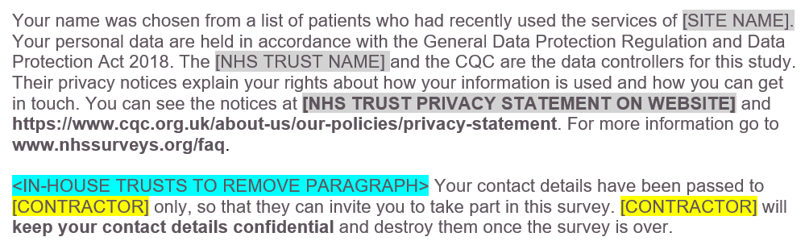
General Data Protection Regulation (GDPR) & National Data Opt-Out Programme
National Data Opt-Out Programme
General data protection regulation (GDPR)
NPSP has received exemption from the National Data Opt-out Programme.
How patients’ personal data is being protected under the GDPR is stated on the reverse side of the covering letter for mailings 1-3:
We will continue to have separate opt-out mechanisms via the dissent posters that need to be displayed across all trusts.
Please note that patients do not have to actively consent to the sharing of their data for the 2026 Urgent and Emergency Care Survey.

Slide 24
Section 251 requirements
We ask that you publicise the survey both internally and externally to ensure patients are aware of the survey and can opt-out should they wish.
Publicity materials (press release template, social media cards, website banner) will be available to download for use on the NHS patient surveys website. The posters can be found in the “Survey Materials” section on the website.
Dissent posters are also now available in the following languages on the NHS patient surveys website:
Arabic, Bengali, Bulgarian, French, Gujarati, Indian Punjabi, Kurdish Sorani, Lithuanian, Polish, Portuguese, Romanian, Russian, Somali, Spanish, Sylheti, Tamil, Tetun, Traditional Chinese, Turkish, Ukrainian, Urdu.
These also provide patients with the opportunity to opt out of the survey, should they wish to do so.
Dissent posters MUST be displayed in all trusts for the duration of February 2026 (and January 2026 for Type 3 samples) to comply with Section 251 requirements.
Please note that the Type 1 and Type 3 surveys have separate dissent posters that will need to be displayed.
Ensure an accurate log of patients who have dissented from taking part in the survey is kept.
Ensure the total number of eligible patients who have dissented from the sharing of their details for any purpose other than their clinical care or who have dissented from taking part in the survey specifically are recorded in your Sample Declaration Form and are excluded from your sample.

Slide 25
Demographic Batch Service (DBS) checks

Slide 26
DBS checks
A minor amend has been made to the process of conducting DBS and local checks for the 2026 Urgent and Emergency Care Survey, in line with changes made for IP25.
What has changed:
DBS and local checks were previously required if it had been more than 2 weeks (10 working days) between the time of the sample being drawn and the first mailing. This has now been adjusted to offer greater flexibility to trusts and contractors.
Going forwards, trusts will have the choice to conduct a DBS check and / or a local check if it has been more than 2 weeks between the time of the sample being drawn and the first mailing being sent. One of these checks MUST be done but both are not necessary.
Trusts and contractors will need to discuss and agree which checks will be conducted (both or just one) and who will be responsible for conducting the checks.
What remains the same:
First checks are completed when the initial samples are drawn by the trusts. Trusts must conduct both a DBS check AND a local check on their initial samples.
After first checks, and upon agreement with the trust, contractors can conduct DBS checks on trusts’ behalf; this includes DBS checks prior to the first mailing and in between each mailing.
DBS and / or local checks must be run prior to the second mailing and third mailing to avoid sending reminders to patients who have died in between mailings.
Drawing sample
DBS check required
Local check required
Mailing 1
If >2 weeks has passed since first checks made:
DBS check and / or local check
Mailing 2
DBS check and / or local check
Mailing 3
DBS check and / or local check

Slide 27
Instruction manuals

Slide 28
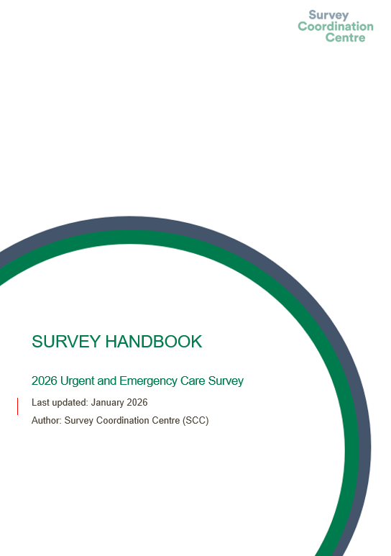

Survey Handbook
For survey leads:
Document outlining step-by-step process for preparing and running the survey.
It is a key summary document that links to all other relevant information regarding the survey handbook.
Includes:
What’s new for the 2026 Urgent and Emergency Survey.
Tips on managing and implementing the survey.
Key dates: top level.
Highlights on key information e.g. Section 251.
This is available for download from the “Instructions and Guidance” section of the NHS patient surveys website.

Slide 29
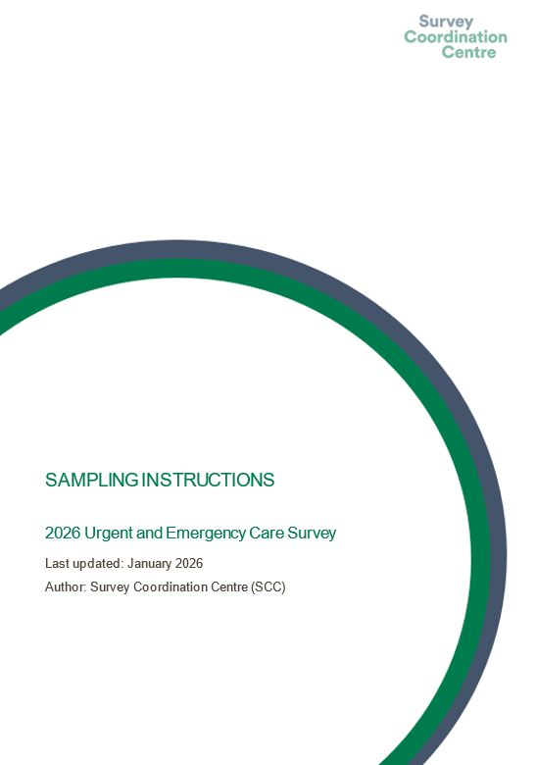
Sampling Instructions
For sample drawers (data team):
Document outlining step-by-step process for how to draw your sample.
Key summary document that links to all other relevant information regarding survey sampling.
Includes:
Overview of the sample drawing process.
Details on eligible and ineligible patients.
Information on DBS and local checks for deceased patients.
Checking and submitting your sample.
This is available for download from the “Instructions and Guidance” section of the NHS patient surveys website.

Slide 30
Other sampling documents
Sample Construction Spreadsheets 1 & 2
To be used to construct the sample of eligible patients for the survey.
Two versions are available – Sample Construction Spreadsheet 1 and Sample Construction Spreadsheet 2.
Each version will contain all relevant fields for the sample details, mailing details and fieldwork variables.
Please contact your approved contractor or the SCC team if you are unsure what information is required for the worksheets or have any queries.
Sample Declaration Form
To be used to check your sample has been correctly drawn before submission to your contractor or the SCC team.
Two versions will be available depending on whether you will be using an approved contractor to conduct fieldwork on your behalf or conducting the survey in-house.
Includes:
Instructions on how to complete the form.
Checklist for checks that must be completed for your sample.
Declaration agreement to be completed and signed by both the sample drawer and the Caldicott Guardian prior to submission of the sample.
Please note that any errors or missing information in the sample declaration form may delay approval of your sample.
If you have any queries about the information required or are uncertain how to complete any of the checks, please contact your approved contractor or the SCC team.
This is available for download from the “Instructions and Guidance” section of the NHS patient surveys website.

Slide 31
Useful NPSP instruction documents
Other instructional documents that are useful for implementing the 2026 Urgent and Emergency Care Survey can be found on the NHS Surveys website:
Patient feedback and the NHS Constitution
Setting up a project team
Data protection and confidentiality
Ethical issues, ethical committees and research governance
Collecting data from non-English speaking populations
Publicising the survey
Implementing the survey – practicalities
Submitting samples
Entering and submitting final data
Making sense of the data
Reporting results
Universal glossary
Updated trust-level benchmark reports

Slide 32
Entering fieldwork

Slide 33
Entering fieldwork early / on time
Entering fieldwork on time or earlier will help your trust to maximise responses from minority ethnic groups. You will also likely receive an overall higher response rate, providing your trust with more data.
Ensure you have a survey team in place before you start drawing your sample.
Generate your sample promptly - begin preparing now.
Respond to queries as soon as possible to avoid unnecessary delays.
Ensure there is sufficient resourcing around the time of drawing your sample and answering queries – communicate with your team, handover tasks if people are going to be on leave and let your contractor and the SCC know of any updates.
If there are any changes in the survey lead, inform your contractor and the SCC via email.

Slide 34
Key dates

Slide 35
Key dates
More detailed timelines will be made available in the 2026 UEC Survey Handbook for NHS Trusts managing sampling in-house and for those using an approved contractor.
The survey handbook can be found in the “Instructions and Guidance” section of the NHS patient surveys website.
Activity | Date
Section 251 (approval) | Friday 30th January 2026
Publication of sampling materials (survey handbook, sampling instructions, sample construction spreadsheet, sample declaration forms) (following section 251 approval) | February 2026
Publication of patient facing materials (following section 251 approval) | 17th February 2026
Samples drawn by trusts | Monday 2nd March 2026 – Friday 27th March 2026
Submit sample to contractor | TBC by contractors
Submit sample to SCC [for trusts delivering survey in-house only] | Monday 30th March 2026
Sample checking (SCC) | Monday 23rd March 2026 – Friday 17th April 2026
Fieldwork (15 weeks) | Monday 13th April 2026 – Friday 24th July 2026

Slide 36
Any other points for discussion?

Slide 37
If you have any further thoughts or queries, please contact us at emergency@surveycoordination.com

